Slide 1


WELCOME
TO
MY
CLASS

Slide 2
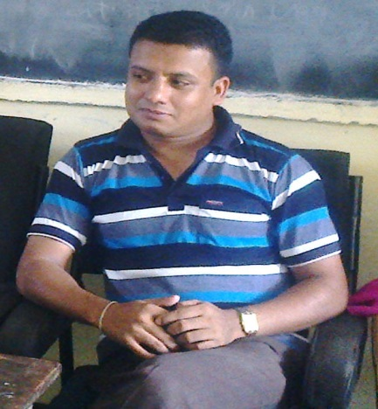
Prepared by -
Karunamoy Dash
Asst. teacher (B.P.Ed)
Abdul Wahab High School
Sreemangal, Moulvibazar
Mobile no - 01712291793,
Email- mrityunjoy161@gmail.com
Greatful to- MD.Nasir uddin (Bahar). Assistant teacher (English)
Jamila Khatun Chowdhury High School.
Mobile:01817204698, E-mail:baharfeni100@yahoo.com

Slide 3
TODAYS LESSON-
NARRATION / SPEECH
( IMPERATIVE)

Slide 4
THE CHANGES OF TO BE & AUXILIARY VERBS
DIRECT
Am, is, are
Shall/will
Can
May
Must
Have/has to
Ought to
INDIRECT
Was/were
would
Could
Might
Had to

Slide 5
CHANGES OF ADVERB OF TIME & PLACE
DIRECT
NOW
TOMORROW
NEXT WEEK
TONIGHT
TODAY
YESTERDAY
LAST NIGHT
LAST WEEK
HERE
THIS
THESE
INDIRECT
THEN
THE NEXT DAY
THE FOLLOWING WEEK
THAT NIGHT
THAT DAY
THE PREVIOUS DAY
THE PREVIOUS NIGHT
THE PREVIOUS WEEK
THERE
THAT
THOSE

Slide 6
HOW TO IDENTIFY AN IMPERATIVE SENTENCE
1. P.V + Obj + ……..
Or, Don’t + P.V + Obj + ……
2. Please + ,, + ,,+ ………..
3. Let + …………

Slide 7
SOME CHANGES-
WHEN AN IMPERATIVE IS STARTED BY WRITING ‘P.VERB OR DON’T’
WHEN AN IMPARATIVE IS STARTED BY WRITING ‘PLEASE’
indirect | Direct
Said | ordered/ commanded / Advised / suggested
, | to / not to
 | Rest of the sentence from reported speech
indirect | Direct
Said | requested
, | to / not to
 | Rest of the sentence from reported speech

Slide 8
WHEN AN IMPARATIVE IS STARTED BY WRITING ‘LET’
DIRECT | INDIRECT
said | proposed
, | that
reported speech | Sub + should + …….(let us) Or, sub + might +…….(let me)

Slide 9
COMMAND EXAMPLE ( individual work)
DIRECT
The teacher said to me, Open your book.”
Sima said to Manu, “Give me a piece of paper.”
Rony said him, “Call me tonight.”
The teacher said to me, “Don’t smoke.”
She said to Riya, “Please come here”
INDIRECT
The teacher ordered me to open my book.
Sima requested Manu to give her a piece of paper.
Rony ordered him to call him that night.
The teacher advised me not to smoke.
She requested Riya to go there.

Slide 10
COMMAND EXAMPLE (pair work)
DIRECT
1. Sana asked Emon, “Don’t leave me alone anymore.”
2. Bimala asked Indra, “Don’t hurt me anymore.”
3. Subho told them, “Don’t disturb me.”
4. Beli said to me, “Let’s go out.”
5. Tina said to Rina, “Let us enjoy this song.”
6. He said to them, “Let me finish.”
INDIRECT
1. Sana asked Emon not to leave her alone anymore.
2. Bimala asked Indra not to hurt her anymore.
3. Subho told them not to disturb him.
4. Beli proposed me that we should go out.
5. Tina proposed Rina that they should enjoy that song.
6. He proposed them that he might finish.

Slide 11
EVaLUaTION
Oral solution-
Try to say what you will use at the place of said, comma and what you will change of reported speech of the following passage-
“Palash, stand up. Haven’t you completed your homework? Let me see this,” the teacher said.

Slide 12
EXERCISE AT HOME
Change the passages into indirect from direct-
1. The students said to the teacher, “We can’t do our assignment. Please help us to complete this.” The teacher said, “Don’t worry. Let’s try again.”
2. My uncle said to my sister, “I won’t be able to come to your birthday party next month. Don’t missunderstand me. Enjoy the party and be happy.”

Slide 13




Thank you for being with me.
Good bye

